Slide 1
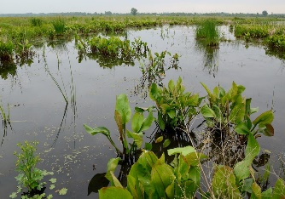
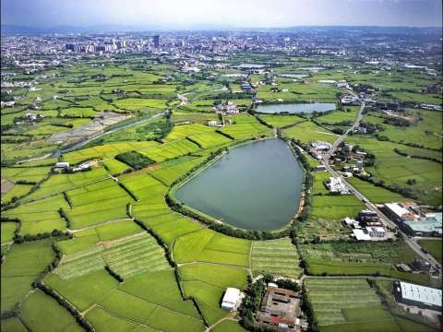
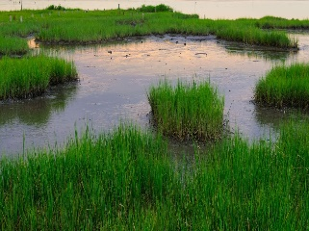

Box in the Water Our IoT solution to Secure the Farming in TAIWAN
LAI, CHIEN-HONG, PhD candidate of CMEE, NTUT
CHANG, FANG-YI, Data Analyst of DTI, III
Dr. TSENG, LAN-TING, Project Manager of DTI, III

Slide 2
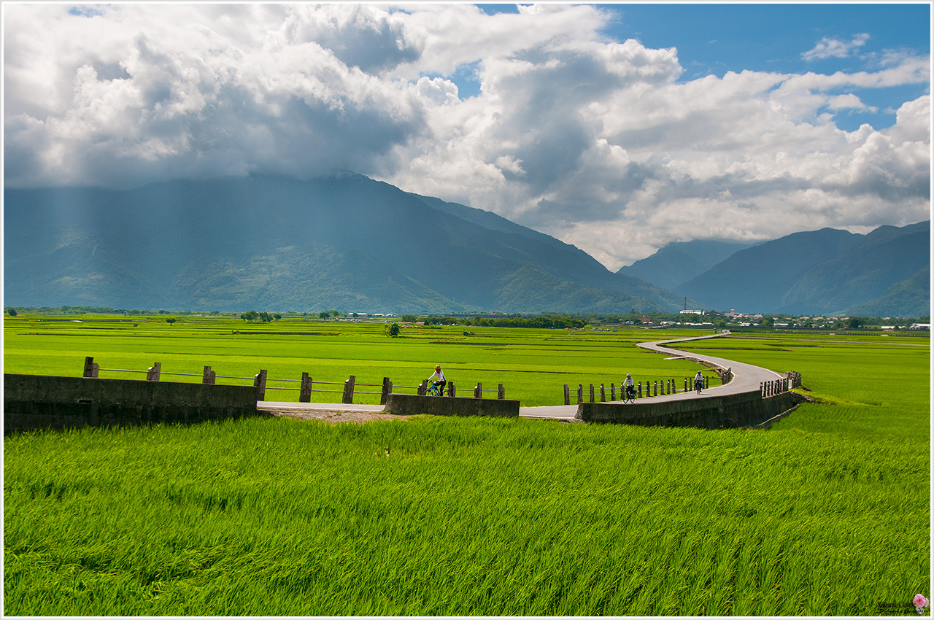
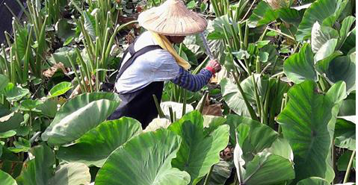
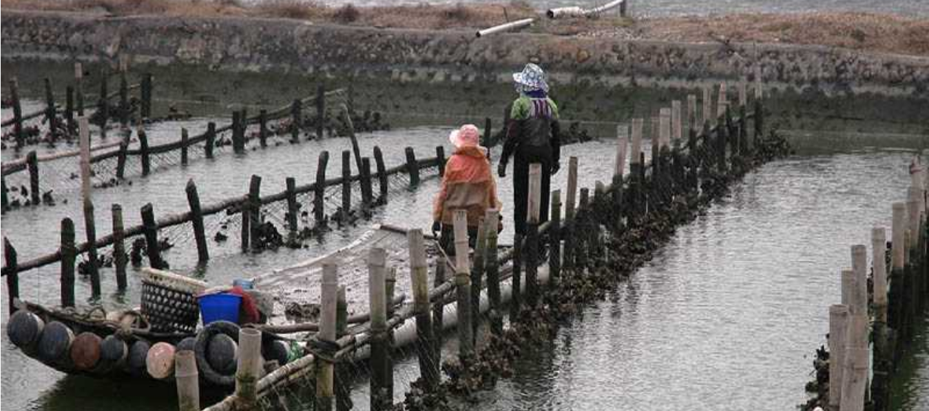
What we CONCERN?
In the supply chain of our foods, water matters!
What can we do on WATER of farming system in Taiwan?
Based on IoT & Data Science, what completes the profiling of foods in our dining table?
Notes:
由於台灣生鮮的供應鏈大部份來自農業地帶，故在農漁牧生產地區水的品質是非常關鍵性的生產要素。
本團隊係透過複合式水質感測器｢水盒子｣(Box in Water)偵測出水域中危害食安的物質，即時感測與發送資料封包到雲端，再把蒐集到的水質資料予以可視化，再用地理資訊系統把資料mapping出來。
再以收集到的即時感測水質數據作為基礎，不僅提供汙染超標的即時監控與告警功能外，還能以等值線分析描繪出可確保食安的水質範圍的優良區位。
尤其是水質敏感的作物或水產養殖產業，例如：外傘頂洲一帶養殖蚵蠣的水質監控或者是生產｢低鉀蔬菜｣最佳選址分析等，提供最適化分析的決策工具。

Slide 3
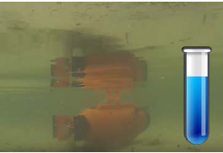
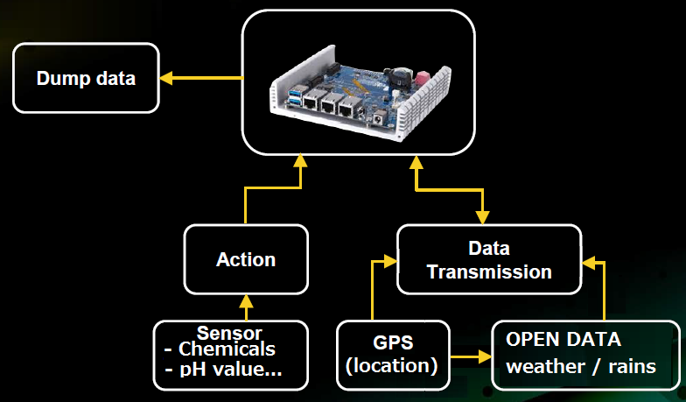
What’s the SOLUTION on water inspection?
The prototype of DEVICE
DATA STREAMING
SYSTEM FRAMEWORK
Mixed Data Sources :
Sensors to collect data in real time
open data(weather, maps,… )
GPS(Altitude, Latitude) marked via HERE platform
Data Target via RESTful API:
the data queue from the merge table in form of URL to serve users
Notes:
Data sources : sensors, open data(weather, traffics,....) or GPS(Altitude, Latitude)
Data Target : the data queue(??) from the merge table in form of HTML or URL via RESTful API to serve user....
研究方法:關於酸鹼值、導電度（正比於水的污染程度）、水溫，並且可以取得樣本水進行更進一步的化學檢測
本團隊係透過複合式水質感測器｢水盒子｣(Box in Water)偵測出水域中危害食安的物質，即時感測與發送資料封包到雲端，再把蒐集到的水質資料予以可視化，再用地理資訊系統把資料mapping出來

Slide 4
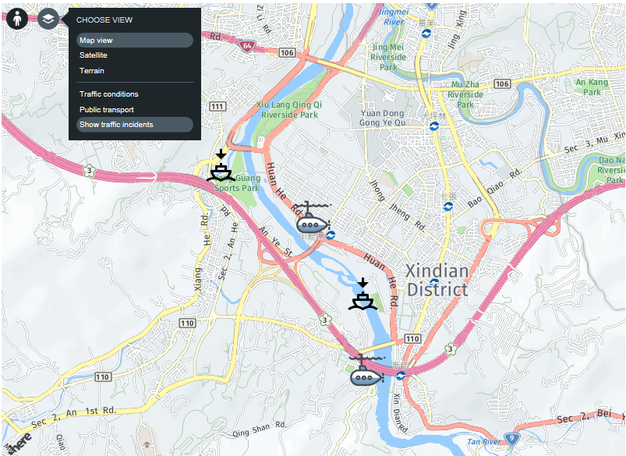
What we IMPLEMENT??
The sailing route of
‘Box in Water’
A walking sensor in marine
Collect multiple data in the water
Report in real time via Cloud
Mapping out the distribution of the monitoring devices
To visualize the measuring of chemicals in statics
Notes:
研究對象: Chemical distribution in the Water fields
本團隊係透過複合式水質感測器｢水盒子｣(Box in Water)偵測出水域中危害食安的物質，即時感測與發送資料封包到雲端，再把蒐集到的水質資料予以可視化，再用地理資訊系統把資料mapping出來。

Slide 5
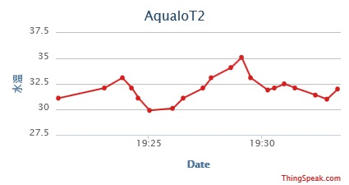
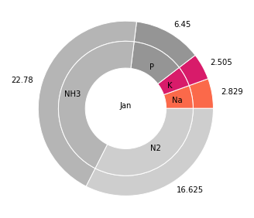
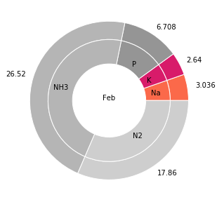
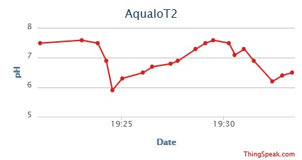
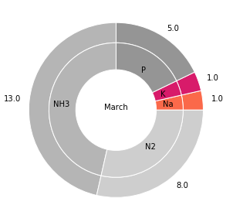
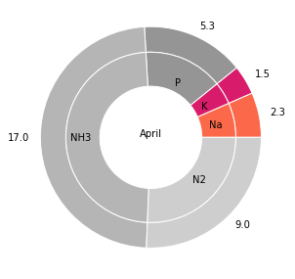
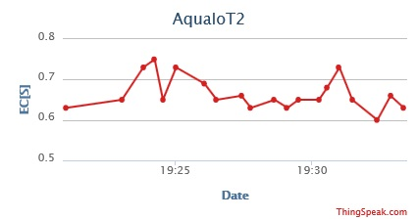
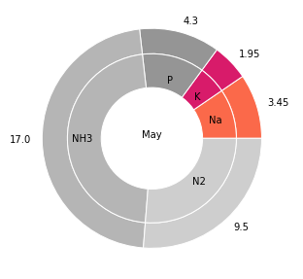
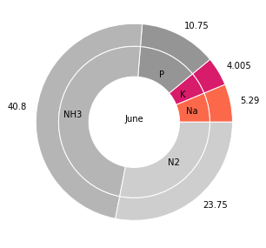
What we serve with REAL-TIME ANALYSIS?
Temperature
The distribution of Chemicals
JAN
FEB
pH value
MAR
APR
EC[S] value
MAY
JUN
Notes:
請簡述作品核心技術與創意之處(200字內)*
1
2.｢優化產品｣：為了遠端體積輕巧方便攜帶或搬運，也容易與各式載具結合進行偵測，可適用於各式水域或場域中定位設置。
3.｢智慧加值｣：是本研究以等值圖模式分析即時感測水質數據後，套疊上農委會開放資料平台...

